Slide 1
Instructions
Step 1:
Try to identify each of Canada’s province and territory.
Click on the province to discover the answer
Next

Slide 2
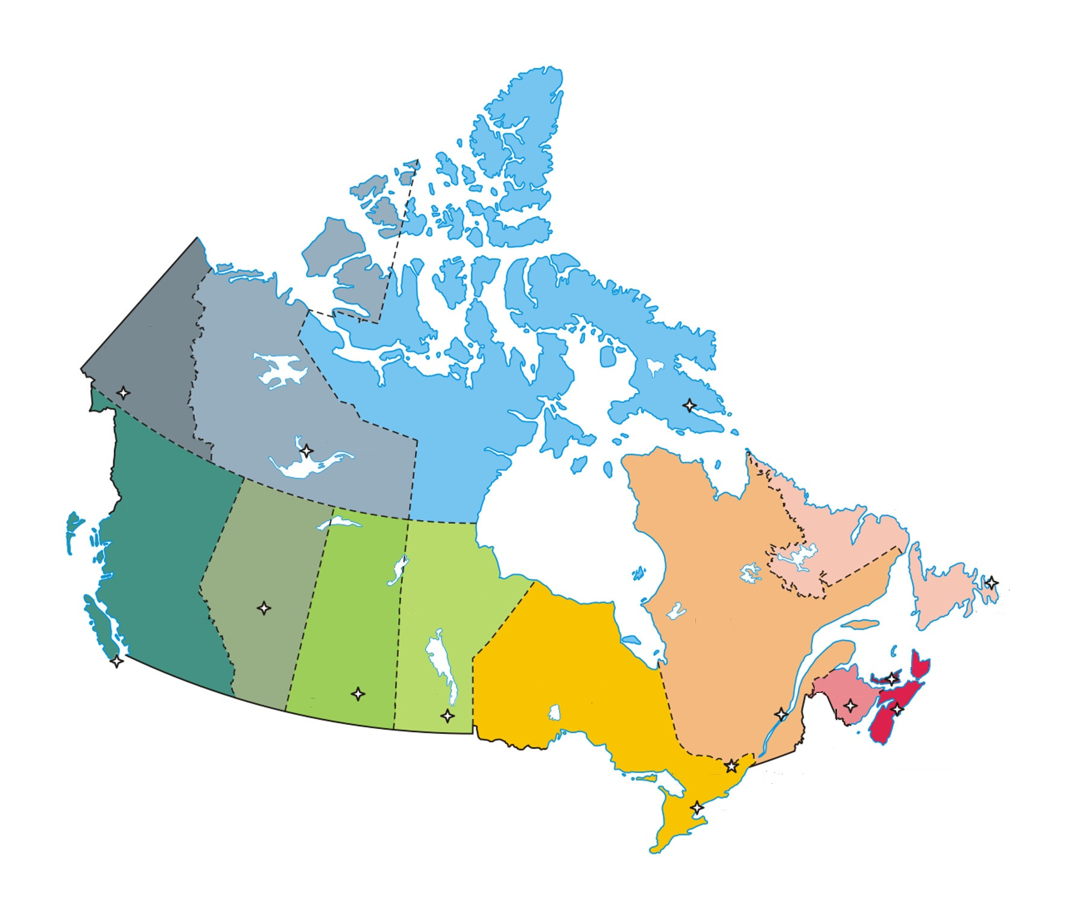
MAP OF CANADA
Yukon Territory
Northwest Territories
Nunavut
British Columbia
Alberta
Newfoundland
Saskatchewan
Quebec
New Brunswick
Manitoba
Ontario
Prince Edward Island
Nova Scotia
Next

Slide 3
Step 2:
Try to find the capital city for each province
Next

Slide 4
Whitehorse
Yukon
Territory
Northwest
Territories
Iqaluit
Nunavut
Yellowknife
British
Columbia
Alberta
St. John’s
Newfoundland
Manitoba
Quebec
Saskatchewan
Winnipeg
Quebec City
PEI
Ontario
New
Brunswick
Charlottetown
Victoria
Edmonton
Nova Scotia
Regina
Fredericton
Halifax
Toronto
Next

Slide 5
BONUS QUESTION: What is the federal capital of Canada? Try to find it on the map.
Next

Slide 6
Yukon
Territory
Northwest
Territories
Nunavut
British
Columbia
Alberta
Newfoundland
Manitoba
Quebec
Saskatchewan
PEI
Ontario
New
Brunswick
Nova Scotia

Slide 7
Yukon
Territory
X
Northwest
Territories
Nunavut
British
Columbia
Alberta
Newfoundland
Manitoba
Quebec
Saskatchewan
PEI
Ontario
New
Brunswick
Nova Scotia

Slide 8
Yukon
Territory
Northwest
Territories
Nunavut
British
Columbia
Alberta
Newfoundland
Manitoba
Quebec
Saskatchewan
PEI
Ontario
New
Brunswick
Nova Scotia

Slide 9
Yukon
Territory
Northwest
Territories
Nunavut
British
Columbia
Alberta
Newfoundland
Manitoba
Quebec
Saskatchewan
Ottawa
PEI
Ontario
New
Brunswick
Nova Scotia

